Slide 1
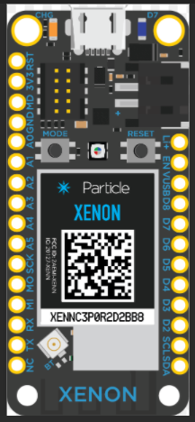
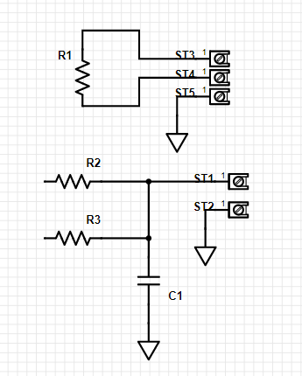
Temperature and Moisture Sensor Schematic
To
Temperature
Sensor
To
Moiusture
Sensor
3x AA
Power

